Slide 1
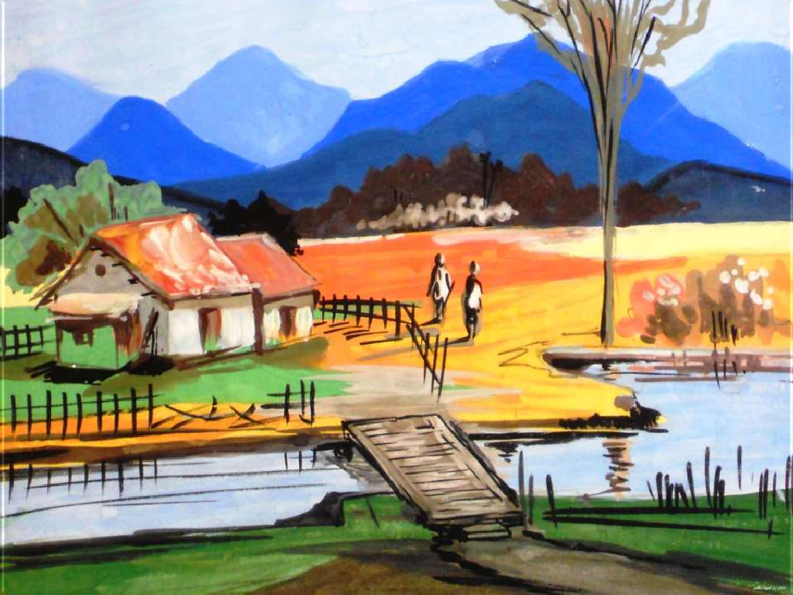







Slide 2

Palampur is an imaginary village . Farming is the main activity in Palampur, whereas several other activities such as small scale manufacturing, dairy, transport, etc. are carried out on a limited scale. These production activities need various types of resources natural resources, manmade items, human effort, money, etc.
Palampur is well-connected with neighboring villages and towns. Raiganj, a big village, is 3 km from Palampur. An all weather road connects the village to Raiganj and further on to the nearest small town of Shahpur. Many kinds of transport are visible on this road starting from bullock carts, tongas, bogeys (wooden cart drawn by buffalos) loaded with jaggery (gur) and other commodities to motor vehicles like motorcycles, jeeps, tractors and trucks.

Slide 3

This village has about 450 families belonging to several different castes. The 80 upper caste families own the majority of land in the village. Their houses, some of them quite large, are made of brick with cement plastering. The SCs (Dalits) comprise one third of the population and live in one corner of the village and in much smaller houses some of which are of mud and straw.
Electricity powers all the tube wells in the fields and is used in various types of small business. Palampur has two primary schools and one high school. There is a primary health Centre run by the government and one private dispensary where the sick are treated.

Slide 4
The aim of production is to produce the goods and services that we want.
There are Three requirements for production of goods and services:
Land,
Labour,
Physical Capital
Physical Capital is further divided into two parts:
Fixed capital &
Working Capital
We have fourth requirement too for production i.e. Human Capital

Slide 5
Land: Land is fixed and scarce. There is not method by which the land can be increased. The growth of population has increased pressure on land. Division of property through subsequent generations has resulted in agricultural plots becoming much smaller. This has also affected the scale economies in farming.
Labour: Labour is available in plenty because of a huge army of unemployed. Many people from the poor section are illiterate and hence have to work as unskilled labour. The government provides guidelines on minimum wages from time to time. But because of less demand and huge supply of labour, there are many cases where the farm workers may not be getting even the minimum wages.

Slide 6
Physical Capital: Physical capital is the variety of inputs required at every stage during production
Fixed Capital: Tools and machines range from very simple
tools such as a farmer’s plough to sophisticated machines such as generators, turbines, computers, etc. Tools, machines, buildings can be used in production over many years, and are called fixed capital.
Working Capital: Production requires a variety of raw materials such as the yarn used by the weaver and the clay used by the potter. Also, some money is always required during production to make payments and buy other necessary items. Raw materials and money in hand are called working capital.

Slide 7
Fourth requirement for Production:
Human Capital: A person also needs the knowledge and enterprise to effectively manage production. In most of the cases, certain knowledge is passed down through generations. Government has also taken initiative in improving the knowledge of farmers.
What is factor of production?
Every production is organized by combining land, labour, physical capital and human capital, which are known as factors of production.

Slide 8
Land is Fixed
Farming is the main production activity in Palampur. 75 per cent of the people who are working are dependent on farming for their livelihood. They could be farmers or farm labourers.
There is a basic constraint in raising farm production. Land area under cultivation is practically fixed. Since 1960 in Palampur, there has been no expansion in land area under cultivation.
By then, some of the wastelands in the village had been converted to cultivable land. There exists no further scope to increase farm production by bringing new land under cultivation.

Slide 9
Is there a way one can grow more from the same land?
Palampur would resemble a village of the western part of the state of Uttar Pradesh. All land is cultivated in Palampur. No land is left idle. During the rainy season (kharif) farmers grow jowar and bajra. These plants are used as cattle feed. It is followed by cultivation of potato between October and December. In the winter season (rabi), fields are sown with wheat. From the wheat produced, farmers keep enough wheat for the family’s consumption and sell the surplus wheat at the market at Raiganj. A part of the land area is also devoted to sugarcane which is harvested once every year. Sugarcane, in its raw form, or as jaggery, is sold to traders in Shahpur.

Slide 10
The Green Revolution in the late 1960s introduced the Indian farmer to cultivation of wheat and rice using high yielding varieties (HYVs) of seeds. Compared to the traditional seeds, the HYV seeds promised to produce much greater amounts of grain on a single plant. As a result, the same piece of land would now produce far larger quantities of food grains than was possible earlier. HYV seeds, however, needed plenty of water and also chemical fertilizers and pesticides to produce best results. Higher yields were possible only from a combination of HYV seeds, irrigation, chemical fertilizers, pesticides etc.
Farmers of Punjab, Haryana and Western Uttar Pradesh were the first to try out the modern farming method in India. The farmers in these regions set up tube wells for irrigation, and made use of HYV seeds, chemical fertilizers and pesticides in farming. Some of them bought farm machinery like tractors and threshers, which made ploughing and harvesting faster. They were rewarded with high yields of wheat

Slide 11
Will the land Sustain?
Land being a natural resource, it is necessary to be very careful in its use. Scientific reports indicate that the modern farming methods have overused the natural resource base. In many areas, Green Revolution is associated with the loss of soil fertility due to increased use of chemical fertilizers. Also, continuous use of groundwater for tube well irrigation has reduced the water -table below the ground. Environmental resources like soil fertility and groundwater are built up over many years. Once destroyed it is very difficult to restore them. We must take care of the environment to ensure future development of agriculture.

Slide 12
How is Land distributed between the farmers of Palampur?
We have realized how important land is for farming. Unfortunately, not all the people engaged in agriculture have sufficient land for cultivation. In Palampur, about one third of the 450 families are landless, i.e. 150 families, most of them Dalits, have no land for cultivation.
more than half the area of the village is covered by plots that are quite large in size. In Palampur, there are 60 families of medium and large farmers who cultivate more than 2 hectares of land. A few of the large farmers have land extending over 10 hectares or more.

Slide 13
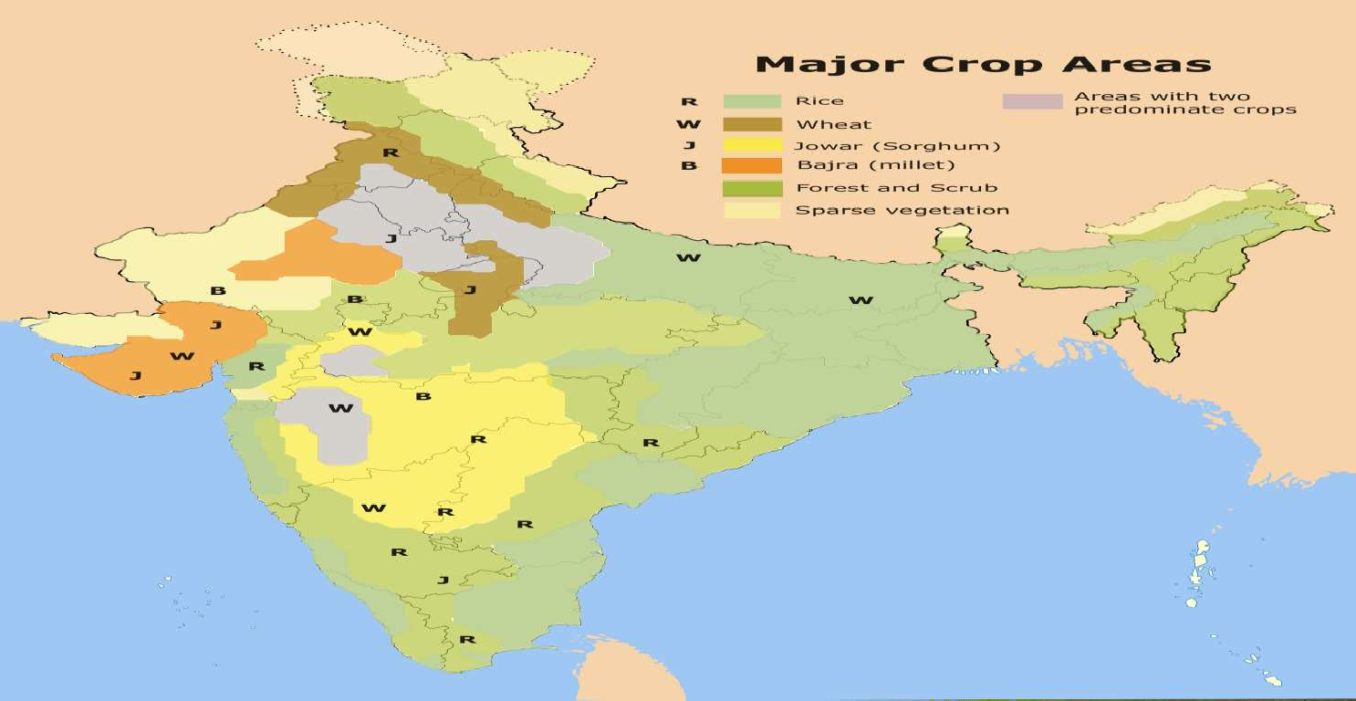

Slide 14
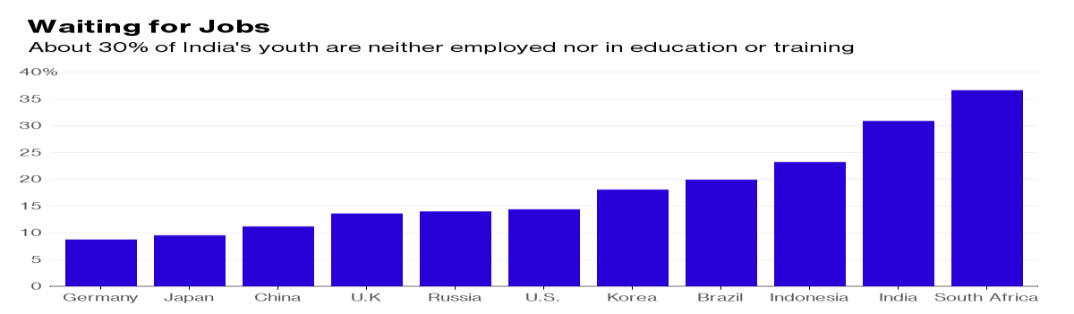
Who will provide the labour?
After land, labour is the next necessary factor for production. Farming requires a great deal of hard work. Small farmers along with their families cultivate their own fields. Thus, they provide the labour required for farming themselves. Medium and large farmers hire farm labourers to work on their fields.

Slide 15
The capital needed in farming
We already know that the modern farming methods require a great deal of capital, so that the farmer now needs more money than before.
  Most small farmers have to borrow money to arrange for the capital. They borrow from large farmers or the village moneylenders or the traders who supply various inputs for cultivation. The rate of interest on such loans is very high. They are put to great distress to repay the loan.
  In contrast to the small farmers, the medium and large farmers have their own savings from farming. They are thus able to arrange for the capital needed.

Slide 16
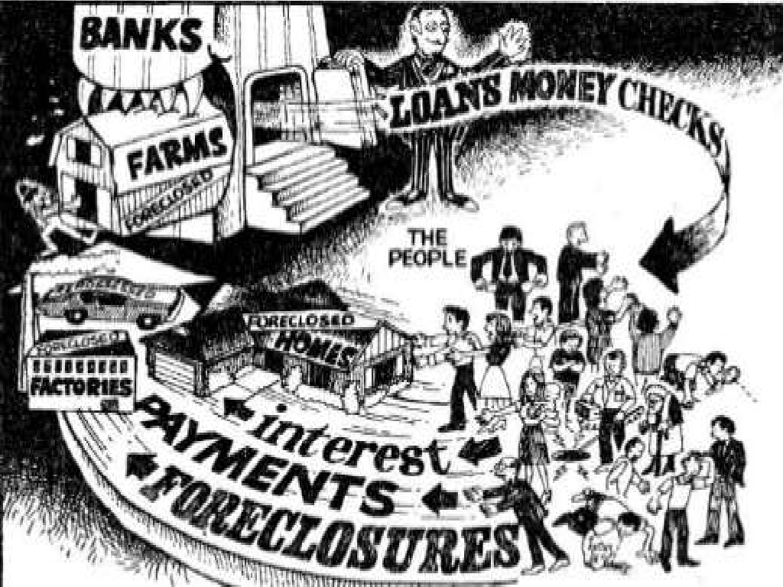

Slide 17
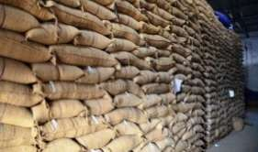
Sale of Surplus from products
The farmers have produced wheat on their lands using the three factors of production. The wheat is harvested and production is complete. Farmer retain a part of the wheat for the family’s consumption and sell the surplus wheat. The traders at the market buy the wheat and sell it further to shopkeepers in the towns and cities. Thus, they are able to arrange for the capital for farming from their own savings.
Some farmers might also use the savings to buy cattle, trucks, or to set up shops

Slide 18
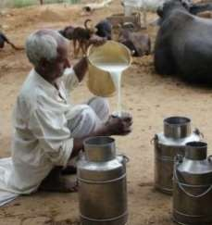
Dairy
Dairy is a common activity in many families of Palampur. People feed their buffalos on various kinds of grass and the jowar and bajra that grows during the rainy season. The milk is sold in Raiganj, the nearby large village. Two traders from Shahpur town have set up collection cum chilling centers at Raiganj from where the milk is transported to far away towns and cities.

Slide 19
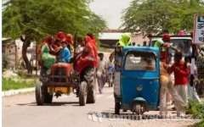
Transport
There are variety of vehicles on the road connecting Palampur to Raiganj. Rickshawallahs , tongawallahs, jeep, tractor, truck drivers and people driving the traditional bullock cart and bogey are people in the transport services. They ferry people and goods from one place to another, and in return get paid for it. The number of people involved in transport has grown over the last several years.

Slide 20
Now Let’s see this vedeo:
https://www.youtube.com/watch?v=5sBga_8Orxc

Slide 21


